Slide 1

JavaScript runtime
Search for training
Sep
2022

Slide 2

What is the runtime environment?
A runtime environment is where your program will be executed.
JavaScript is a single threaded at runtime unlike the other programming language
- The runtime environment of a browser
- The node runtime environment

Slide 3

A browser runtime environment
The most common place where executed JavaScript code is in a browser
The JavaScript engine
Web APIs
The callback queue
The event loop

Slide 4
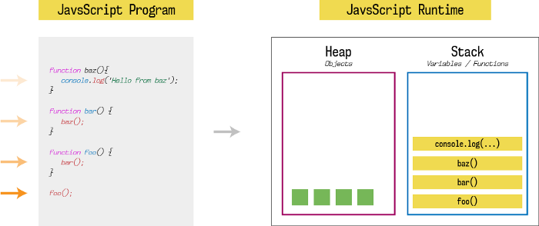
The java script engine
each web browser has its own version of the JS engine that parses the code. JavaScript runtime has one stack and one heap storage per process
A heap is a free memory storage unit where you can store memory in random order.
A stack is LIFO data storage that stores the current function execution context of a program. And when execute it popped from stack.

Slide 5
Web APIs
The Web APIs are not a part of the JavaScript engine, but they are part of the runtime environment provided by the browser.
Features like event listeners, timing functions and AJAX requests all sit in the Web APIs container until an action gets triggered
A request finishes receiving its data, a timer reaches its set time or a click happens and this triggers a callback function to be sent to the callback queue.

Slide 6
Callback queue
It’s also called a message queue or task. The callback queue stores the callback functions sent from the Web APIs in the order in which they were added.

Slide 7
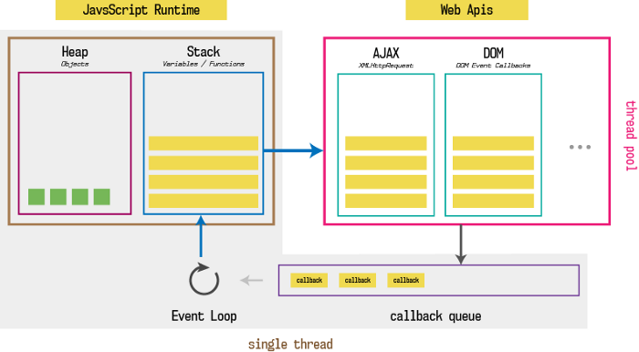
Event loop
The job of the event loop is to constantly monitor the state of the call stack and the callback queue.
This is why JavaScript often gets described as being able to run asynchronously, even though it is a single-threaded language.
In most browsers there is an event loop for every browser tab

Slide 8
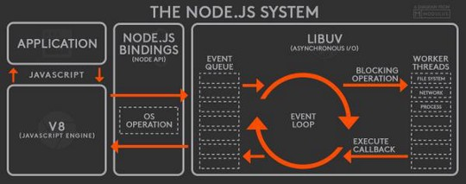
Node runtime environment
The Node runtime environment was created in 2009 to execute JavaScript code without a browser.
Node.js uses Google’s V8 engine to provide JavaScript runtime and employs its own event loop using the libuv library which written in c language.
V8, event queue, and event loop runs on the single thread while worker threads are responsible to provide asynchronous I/O operation.
Node.js is said to have as non-blocking event-driven asynchronous I/O architecture.

Slide 9
COMPARISON
There are several differences between them, mostly because the node is outside of the browser
Browser runtime
Node runtime
Used the browser environment data values and functions, like window.alert ().
the node runtime environment gives back-end applications access to many of features unavailable in a browser, such as access to server’s file system, database and network
The node contains some of functions not present in browser such like process.nextTic().

Slide 10

THANK YOU!
Omar Dere
Phone
059-228-9271
Email
omarderi80@gmail.com

